Slide 1

AI Coach
Project Group ID ”29” Eman Tamam Mohamed : 162021069 Yasmeen Khaled Mohamed : 162021387 Arwa Mostafa Mohamed : 162021047
Dept. of Computer Science College of Computers and Information , Assiut University
1

Slide 2
Task Description
Task description
The AI Coach app is designed to function like a real coach, guiding you on your journey towards a healthy lifestyle. It detects the exercise you are performing and provides feedback on whether it is being executed correctly or not.
The AI Coach is a safe way to work out at home, eliminating any concerns about performing exercises incorrectly or in a dangerous manner.
The exercises in this are: push-ups, Crunches, and Squats.
2

Slide 3
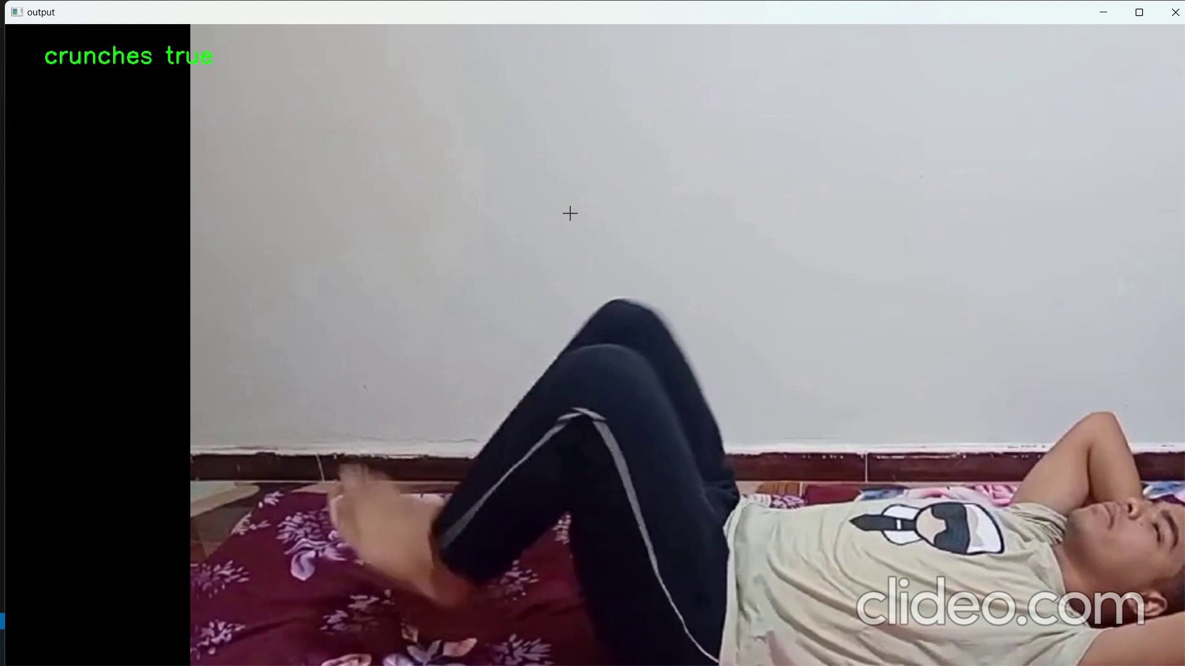
Demo
3
https://github.com/Eman288/AI-Coach/tree/main

Slide 4
Contribution
Modifying the dataset.
defining the "load_dataset" function to load the data from our dataset.
Using a mediapipe solution ”Pose Landmark Detection”.
Converting the labels of the dataset into numerical values.
Building the model from different resources using the Keras.
Setting the number of epochs to 150.
Saving the model to “model.keras” file.
Enable the use of webcam in the model.
Printing the result on the window, not the console.
4

Slide 5
Data
We brought a dataset that was made for the push_up exercise from “Kaggle”
We modified the dataset and added our data to make it learn another two exercises
The dataset consists of 6 folders, each exercise has two folders so the labels are either true or false
Each folder contains 40-61 video
5

Slide 6
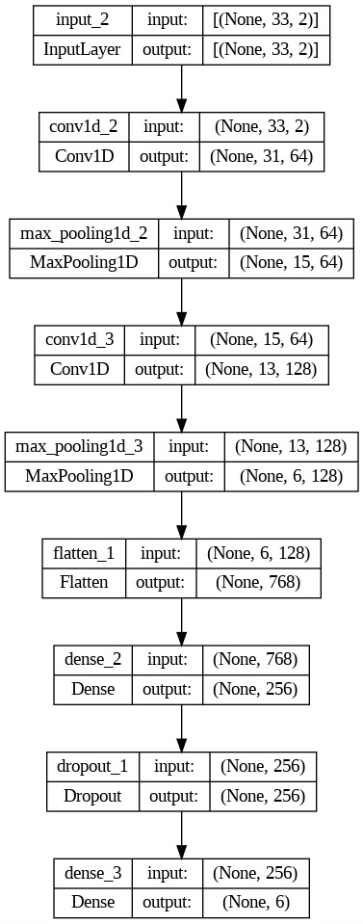
Project Architecture
Proect architecture
6
Fig 1: model architecture

Slide 7
Methods
The model created with Tensorflow keras
Using the pose landmark detection from mediapipe
This model consists of 9 layers:
1 Input, 2 Conv1D with “relu” activation function, 2 Maxpooling1D, 1 Flatten, 2 Dense one with “relu” activation function and the other with “softmax” activation function, 1 Dropout
The epoch number is 150
The optimizer is 'adam', the loss function is ‘sparse_categorical_crossentropy', and the metrics is 'accuracy'
The number of classes is 6
7

Slide 8
Results
Accuracy: 0.9896 (98.96%)
Loss: 0.0262 (2.62%)
Metrics: “accuracy”
8

